Slide 1


Predicting Diabetes
Scientific Data Analysis 25/26
Yael Ai, 14716674
Jelmer van Dam, 14802333
Glenn de Graaff, 1514913
Wong Zheng Tat, 16365453

Slide 2
Background
Diabetes is a growing global health issue, affecting hundreds of millions of people worldwide. Early detection plays a crucial role in preventing severe health complications and improving long-term outcomes. Machine learning has already shown promise in predicting diabetes risk.
Our goal is to recreate and validate this idea ourselves, using the techniques and statistical methods we have learned in this course. By applying scientific data analysis to a real medical dataset, we aim to:
Identify which factors are most strongly associated with diabetes
Build a predictive model that performs significantly better than random chance
Learn how model selection influences performance

Slide 3
Real World Applications
Identify risk factors for diabetes
Design of efficient population wide screening methods
Practical use by clinicians
Physicians can encourage patients take strong preventive measures against diabetes
Useful for hospitals, governments and pharmaceutical companies
Assess how much they need to spend on buying/developing medications

Slide 4

Research Question 1
Which physiological and metabolic factors allow diabetes status to be predicted better than random chance?
Revised Hypotheses (Predictive Performance)
H0:
A multivariate model using physiological and metabolic predictors does not predict diabetes status better than random chance.
H1:
A multivariate model using physiological and metabolic predictors predicts diabetes status significantly better than random chance.

Slide 5

Research Questions 2
Which factors jointly explain variation in fasting plasma glucose at follow-up (FFPG)?
Global Hypotheses (Overall Model Significance)
H0 (global):
The set of physiological and metabolic predictors explains little to no variance in FFPG.
H1 (global):
The set of physiological and metabolic predictors explains a non-trivial proportion of variance in FFPG.

Slide 6
Research Questions 3
Which model is more appropriate for predicting Type 2 diabetes:
Linear Regression or Logistic Regression?
Model Comparison Hypotheses
H0:
Logistic regression does not perform better than linear regression in predicting Type 2 diabetes.
H1:
Logistic regression is more appropriate than linear regression
in predicting Type 2 diabetes.

Slide 7



Dataset Description
Participants
12,356 adults
247 had diabetes at the follow up
No diabetes at baseline
Measurements (18 factors)​​
Age, gender, BMI​​
Various physiological and metabolic parameters​​
Smoking status, drinking status​​
Family history of diabetes​
Follow-up​
Conducted ~3 years later​
Screening for:​
  FFPG (fasting plasma glucose at final visit)​
  Diabetes status (1 = yes, 0 = no)
Original study:
Chen, Y., Zhang, X. P., Yuan, J., Cai, B., Wang, X. L., Wu, X. L., Zhang, Y. H., Zhang, X. Y.,Yin, T., Zhu, X. H., Gu, Y. J., Cui, S. W., Lu, Z. Q., & Li, X. Y. (2018). Association of body mass index and age with incident diabetes in Chinese adults: a population-based cohort study. BMJ open, 8(9), e021768. https://doi.org/10.1136/bmjopen-2018-021768
Link to dataset used (that was adapted from the study)
https://www.kaggle.com/datasets/pkdarabi/diabetes-dataset-with-18-features/data

Slide 8
Data Pipeline and Methodology
Data Cleaning
Feature Selection
Data Modelling
Results
Correlation
Method 1:
Linear Regression
Results 1
Dataset
Removing missing values
Results 2
Stepwise Selection
Method 2:
Logistic
Regression
Results 3
Results 4
Method 3:
Random Chance
Results 5
Interaction Terms

Slide 9

Factors Indicative of Diabetes
Exploratory analyses were conducted to identify factors that provide meaningful information for predicting diabetes.
Correlation analysis and feature selection procedures suggested that several variables, including age, fasting glucose (FPG), body mass index (BMI), lipid-related measures, and lifestyle factors such as smoking and drinking, contain predictive information relevant to diabetes status.
These variables were subsequently used in predictive modeling, where the resulting models achieved substantially higher accuracy than a random chance baseline, providing evidence against the null hypothesis in a predictive context.
It should be noted that these findings reflect predictive relevance rather than causal relationships.

Slide 10
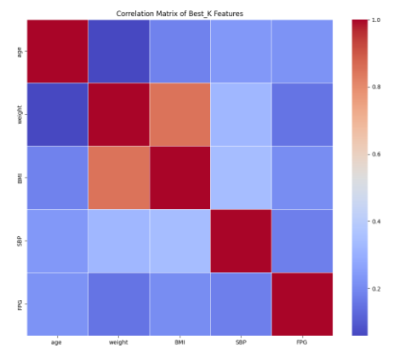
Feature Selection Method 1: Correlation with FFPG
We first looked at Pearson correlations with FFPG
Variables with |r| > 0.5 were considered “strongly associated”
Selected features based on correlation with FFPG:
  Age, weight, BMI, SBP, FPG
  Included an interaction term between BMI and weight

Slide 11
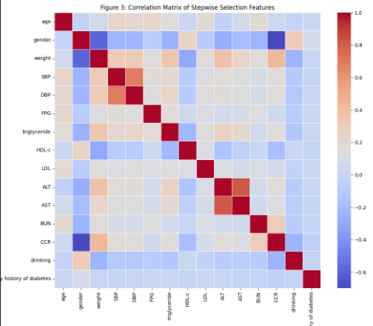
Feature Selection Method 2: Stepwise Selection for Linear Regression
We first looked at Pearson correlations with FFPG
Variables with |r| > 0.5 were considered “strongly associated”
Selected features based on correlation with FFPG:
  Age, Gender, Weight, SBP, DBP, FPG, Triglyceride, HDL – C, LDL, ALT, AST, BUN, CCR, Drinking, Family History of Diabetes
  Included an interaction term between gender and drinking, weight and gender, DBP and SBP, AST and ALT

Slide 12
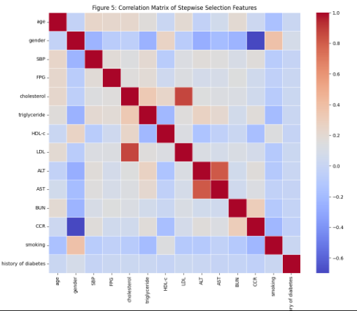
Feature Selection Method 2: Stepwise Selection for Logistic Regression
We first looked at Pearson correlations with FFPG
Variables with |r| > 0.5 were considered “strongly associated”
Selected features based on correlation with FFPG:
  Age, Gender, SBP, FPG, Cholesterol, Triglyceride, HDL-c, LDL, ALT, AST, BUN, CCR, Smoking, family history of diabetes
  Included an interaction term between LDL and Cholesterol, CCR and gender, AST and ALT

Slide 13
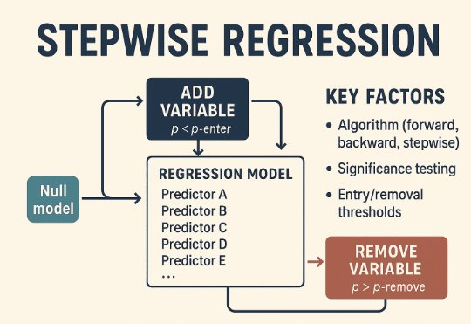
Feature Selection Method 2: Stepwise Selection

Slide 14
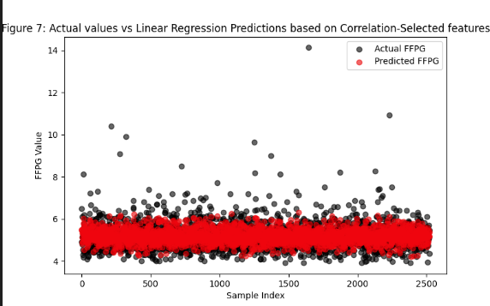
Results 1: Linear Regression with Correlation Selected Features
Model: Linear regression with correlation - selected features
Test performance:
  MSE ≈ 0.287
  R² ≈ 0.256
  Accuracy ≈ 0.987

Slide 15
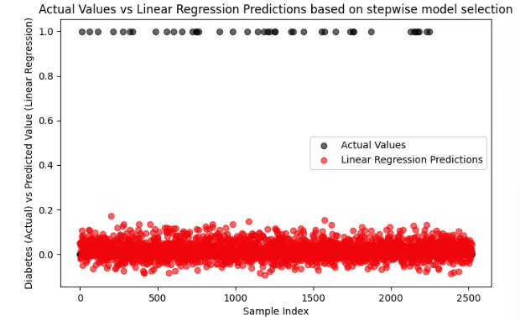
Results 2: Linear Regression with Stepwise - Selected Features
Model: Linear regression with stepwise - selected features
Test performance:
  MSE ≈ 0.287
  R² ≈ 0.258
  A​ccuracy ≈ 0.987

Slide 16
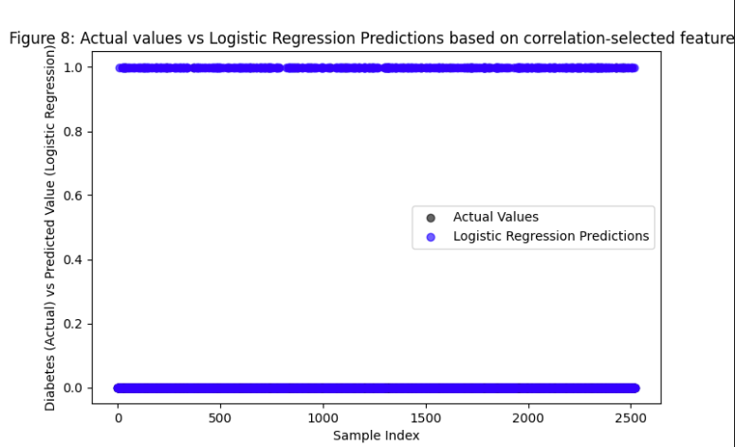
Results 3: Logistic Regression with Correlation - Selected Features
Model: Logistic regression with Correlation - selected features
Test performance:
  A​ccuracy ≈ 0.821

Slide 17
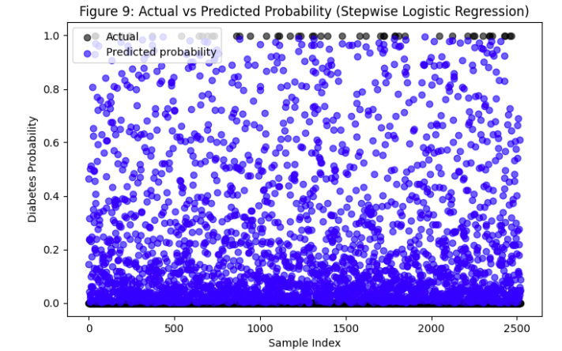
Results 4: Logistic Regression with Stepwise - Selected Features
Model: Logistic regression with Stepwise - selected features
Test performance:
  A​ccuracy ≈ 0.827

Slide 18
Results: Data Pipeline and Methodology
Data Cleaning
Feature Selection
Data Modelling
Results
Correlation
Method 1:
Linear Regression
0.987
Dataset
Replacing NaN with Column Mean
0.987
Stepwise Selection
Method 2:
Logistic
Regression
0.821
0.827
Method 3:
Random Chance
0.495
Interaction Terms

Slide 19
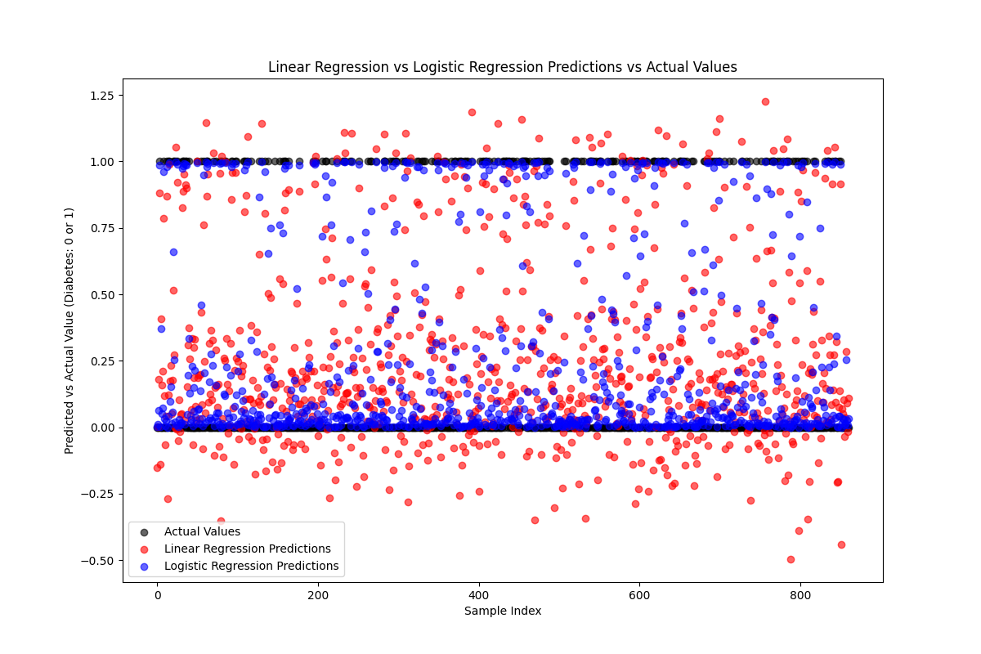
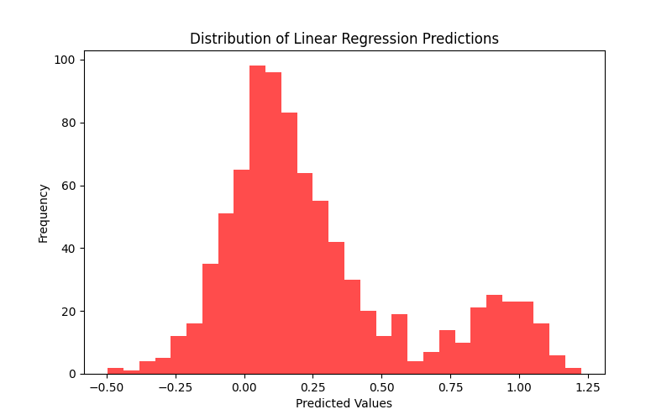
Additional Insights: Model Performance Comparison
Linear regression produces predictions outside the valid probability range [0,1].
The distribution shows invalid linear regression predictions below 0 and above 1.

Slide 20

Conclusion
Answering the research hypotheses:
Logistic regression outperforms linear regression in identifying future diabetes cases.
Although linear regression achieves high overall accuracy, it fails to detect diabetic individuals.
Logistic regression detects >80% of diabetes cases (high recall), which is beneficial for early detection.
Feature selection method (correlation vs. stepwise) does not substantially change model performance.
Logistic regression using physiological and metabolic predictors provides the most reliable and clinically relevant diabetes predictions.

Slide 21
Discussion & Implications
Why accuracy is misleading
Precision–Recall trade-off
The dataset shows severe class imbalance, with only ~2% of participants diagnosed with diabetes.
High accuracy mainly reflects correct predictions of non-diabetic individuals.
A model predicting “no diabetes” for all cases would already achieve very high accuracy.
High recall ensures that most diabetic cases are correctly identified.
Low precision results in a higher number of false positives.
This trade-off is acceptable and often preferred in medical screening, where missing true cases is more costly than false alarms.

Slide 22
Questions?

